Slide 1
SMART AGRICULTURE SYSTEM BASED ON IoT
A.HARIKA

Slide 2
INTRODUCTION
Agriculture plays an important role in any country by emerging technology new strategies are to be to implemented for greater production.
Internet of things IOT consists of two words Internet and Things .The term things in IOT refers to various IOT devices having unique identities and have capabilities to perform remote sensing, actuating and live monitoring of certain sort of data.

Slide 3
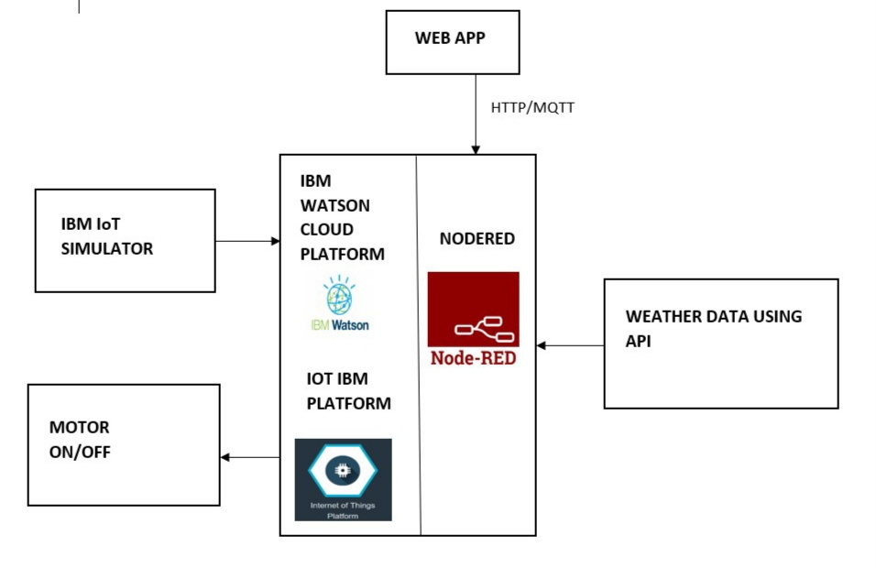
BLOCK DIAGRAM

Slide 4
DESCRIPTION
Smart agriculture based on IoT basically monitors the various parameters which are required for farming.
Here the farmer is provided with mobile app which gives data regarding temperature, humidity along with live weather forecasting.
The Web App further provides buttons to control the motor, even if the farmer is not present near the crop

Slide 5
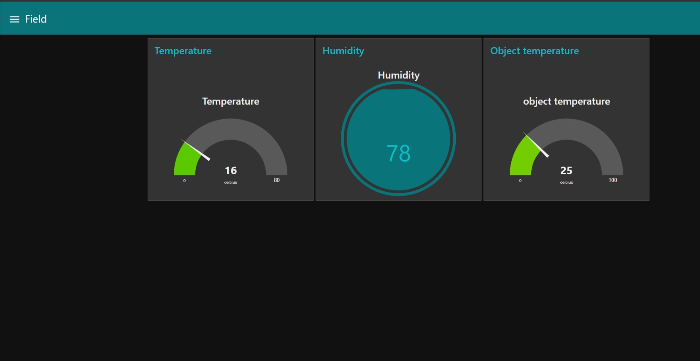
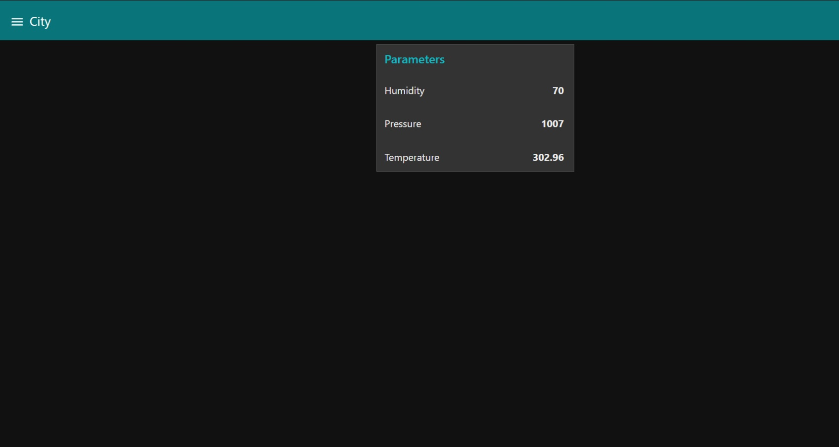
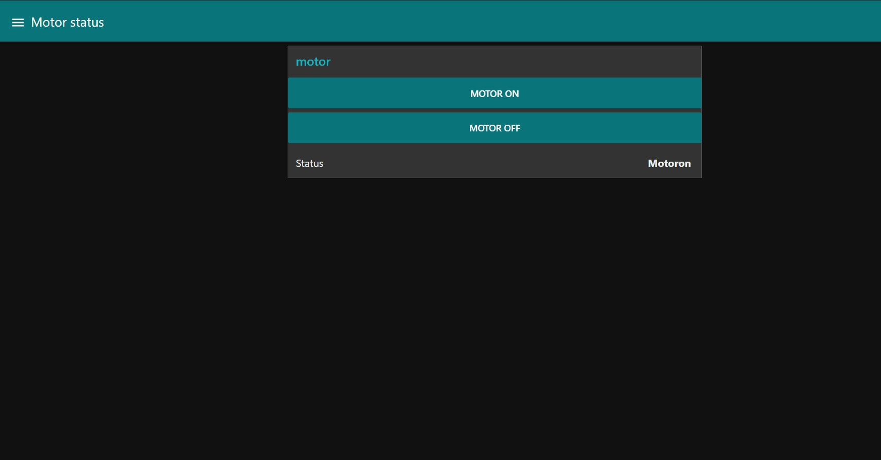
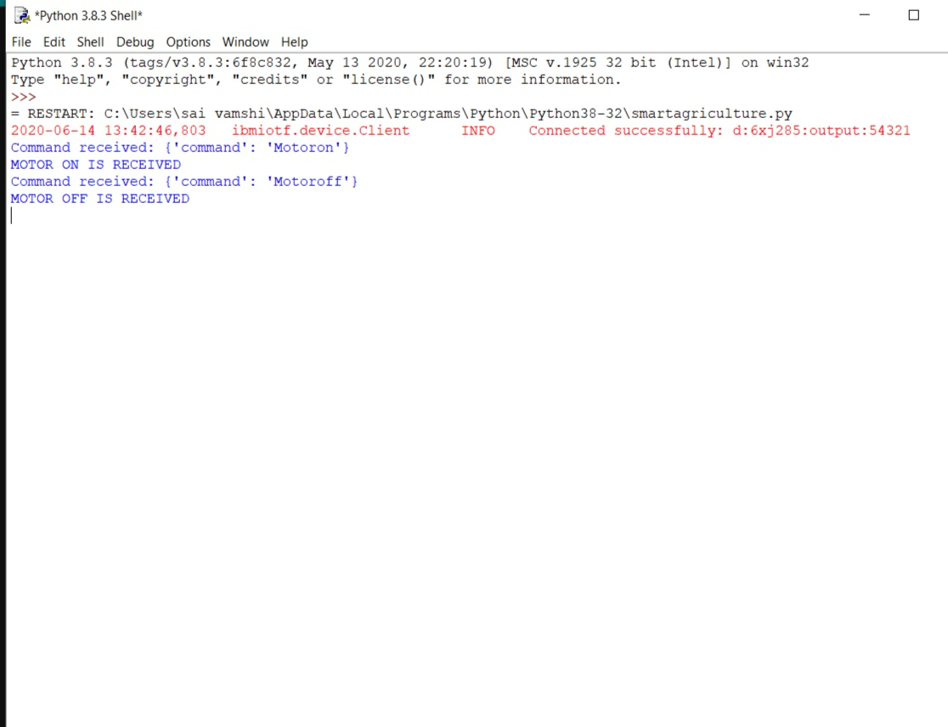

Slide 6
FUTURE SCOPE
Future work would be focused more on increasing other features on this system to fetch more data especially with regard to Pest Control and by also integrating GPS module in this system to enhance this Agriculture IoT Technology to full-fledged Agriculture Precision ready product. we can also add some external features like we can find the soil nutrients contents and help the farm to yield a better crop.

